Slide 1
“The Cloud”
Tom Gregory, PhD
Some content from Prof. Antino Kim, 2018 Prof. Bipin Prabhakar, ages ago
Tech Consulting Workshop
August 3, 2019

Slide 2
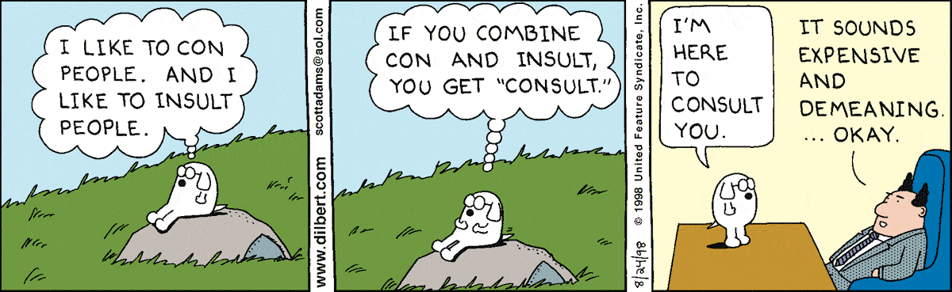
What is Consulting?

Slide 3
The industry is asking…
What is cloud?
How can I get to (leverage) the cloud?
Where’s my stuff on the cloud and who has access to it?
How do I use the cloud?
How can I get out?

Slide 4
So… What is Cloud?
Notes:
Image: Royalty free from VectorStock
https://www.vectorstock.com/royalty-free-vector/pink-unicorn-on-the-cloud-vector-23247546

Slide 5
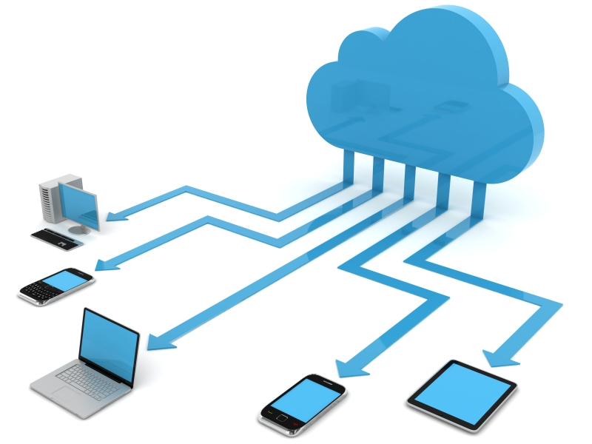
So… What is Cloud?

Slide 6
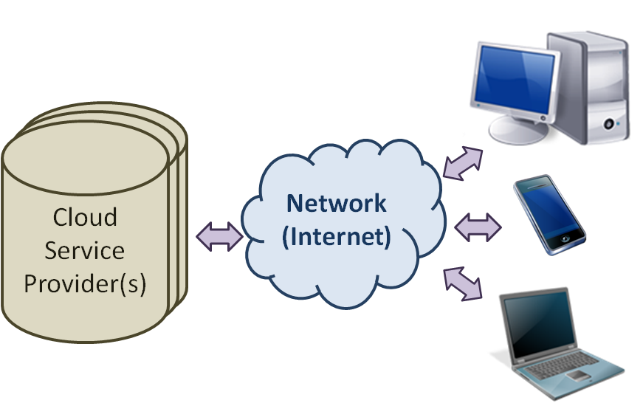
Mystery solved! (sort of…)

Slide 7
The “Cloud” is all the things …
The interesting thing about cloud computing is that we’ve redefined cloud computing to include everything that we already do.
I can’t think of anything that isn’t cloud computing with all of these announcements. The computer industry is the only industry that is more fashion-driven than women’s fashion.
Maybe I’m an idiot, but I have no idea what anyone is talking about. What is it? It’s complete gibberish. It’s insane. When is this idiocy going to stop?
—Larry Ellison, CEO, Oracle, 2008

Slide 8
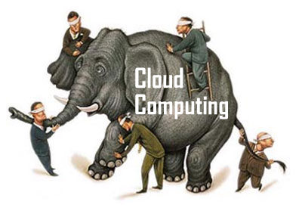
It’s possible that each person understands the cloud differently

Slide 9
We can’t see the cloud
Our definition of cloud computing is multi-tenant, it’s faster, half the cost, pay as you go, it grows as you grow or shrinks as you shrink.
It is extremely efficient. We’re not going to show you computers taller than you. We’re not going to show you a cloud in a box because clouds don’t come in a box.
They never have. That’s the whole idea.
—Marc Benioff, Salesforce.com

Slide 10
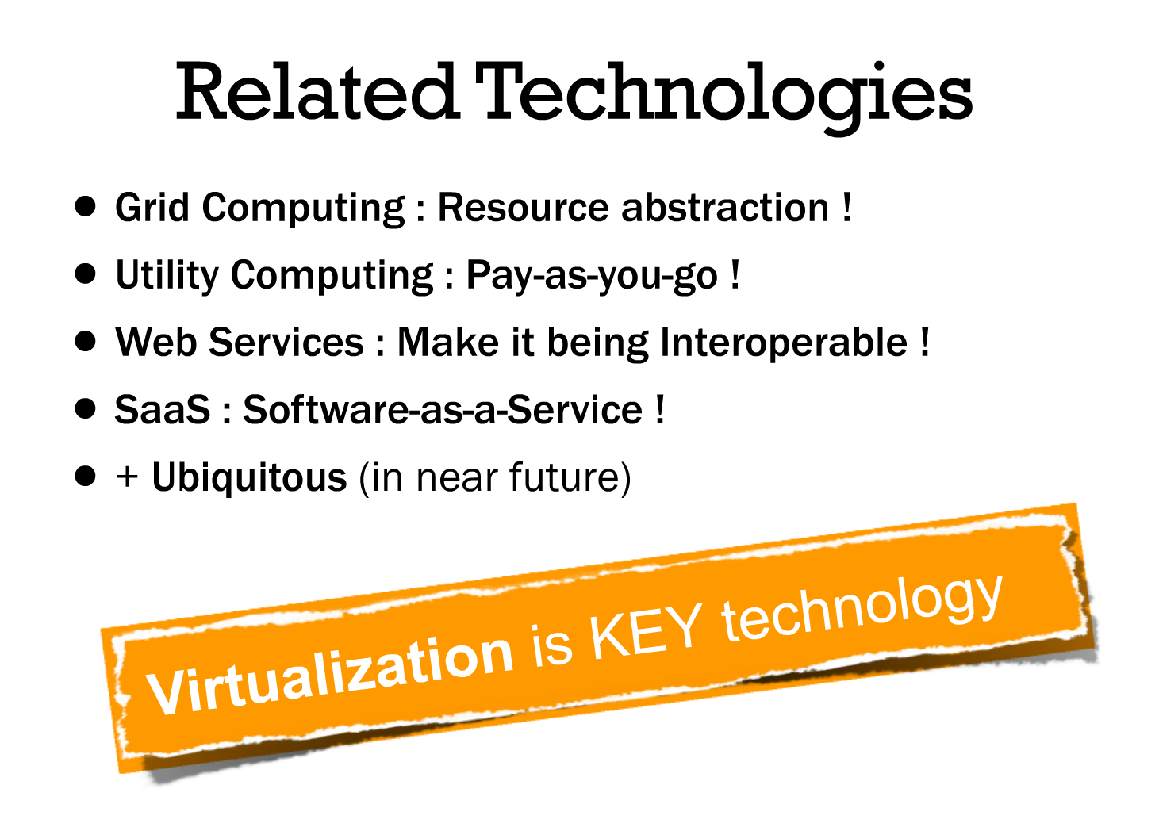
Whatever works, we’ll take it!

Slide 11
Virtualization
Virtualization creates a logical view of resources
Dividing a single physical server into multiple “virtual” servers containing multiple sets of segregated data is the backbone of cloud computing as it allows for far greater flexibility and resource utilization
Several physical disks could be combined into one artificial volume
Makes anytime, anywhere access easier
Notes:
Virtualize hard drives

Slide 12
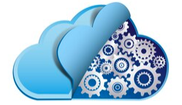
To understand cloud, we have to understand Virtualization
Notes:
Image from Shutterstock

Slide 13
Virtualization
Virtualization creates a logical view of resources
Dividing a single physical server into multiple “virtual” servers containing multiple sets of segregated data is the backbone of cloud computing as it allows for far greater flexibility and resource utilization
Several physical disks could be combined into one artificial volume
Makes anytime, anywhere access easier
Virtualization brings efficiency gains in terms of processing power and saves electric power, space and cooling
Studies have found that cloud applications consume 90% less energy than on-premises ones
Notes:
Virtualize hard drives

Slide 14
Cloud Computing, formally
“Cloud Computing is a model for enabling convenient, on-demand network access to a shared pool of configurable computing resources (e.g., networks, servers, storage, applications, and services) that can be rapidly provisioned and released with minimal management effort or service provider interaction.”
— NIST Special Publication 800-146
Notes:
National Institute of Standards and Technology (NIST)

Slide 15
Let’s launch an on-premises server …

Slide 16
Let’s launch an on-premises server …
Setting up a server always requires a great deal of configuration

Slide 17
Let’s launch an on-premises server …
… that’s better!

Slide 18
What would this look like in the cloud?
Notes:
National Institute of Standards and Technology (NIST)

Slide 19
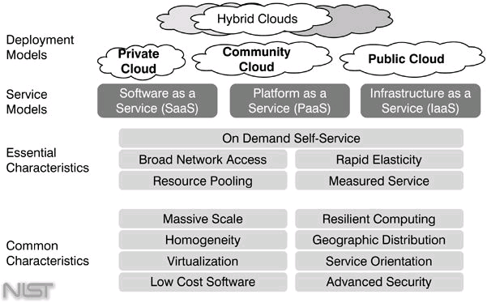
The NIST Cloud Computing Framework Two axes: Deployment and Service
Notes:
National Institute of Standards and Technology (NIST)

Slide 20
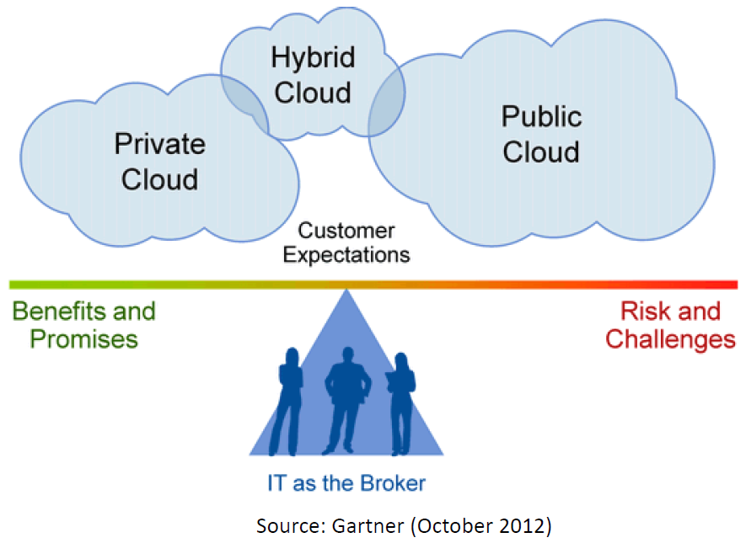
Think along the two axes: Deployment
Cloud Deployment Models
Private cloud
Community cloud
Public cloud
Hybrid cloud
Notes:
Axes: Deployment model / Service model

Slide 21
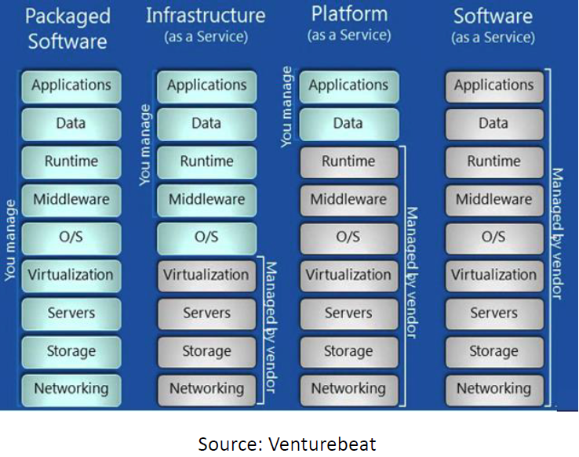
Think along the two axes: Service
Cloud Service Models:
Software as a Service (SaaS)
Platform as a Service (PaaS)
Infrastructure as a Service (IaaS)
Notes:
Axes: Deployment model / Service model

Slide 22
The cloud revolutionized how we use IT
Virtualization The ability to increase computing efficiency
Democratization of computing
Enterprise scale infrastructure available to
small and medium businesses
Scalability and fast provisioning Web scale IT at a rapid pace, on demand
Commoditization of infrastructure Allow IT to focus on the strategic aspects of its role

Slide 23
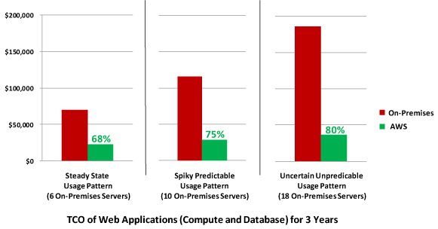
Savings from Using AWS

Slide 24
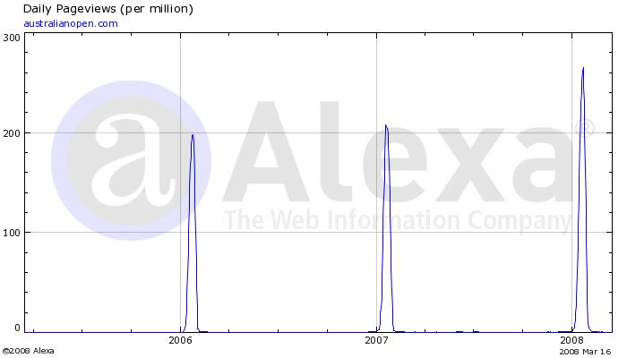
Scalability and Fast Provisioning
Think about load fluctuation…

Slide 25
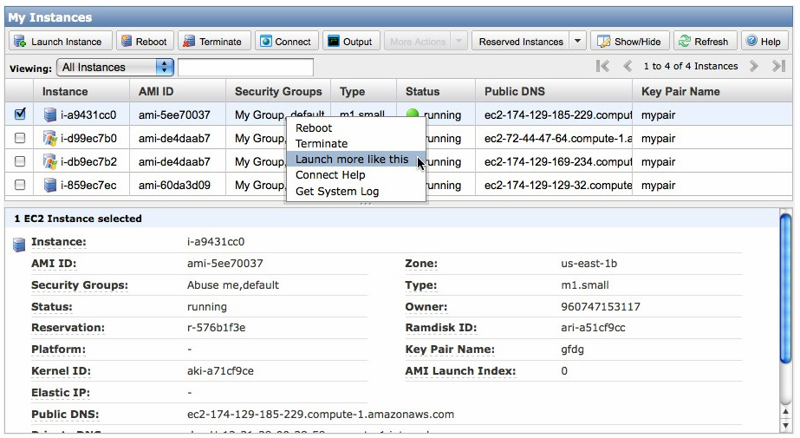
Let there be… an instance!

Slide 26
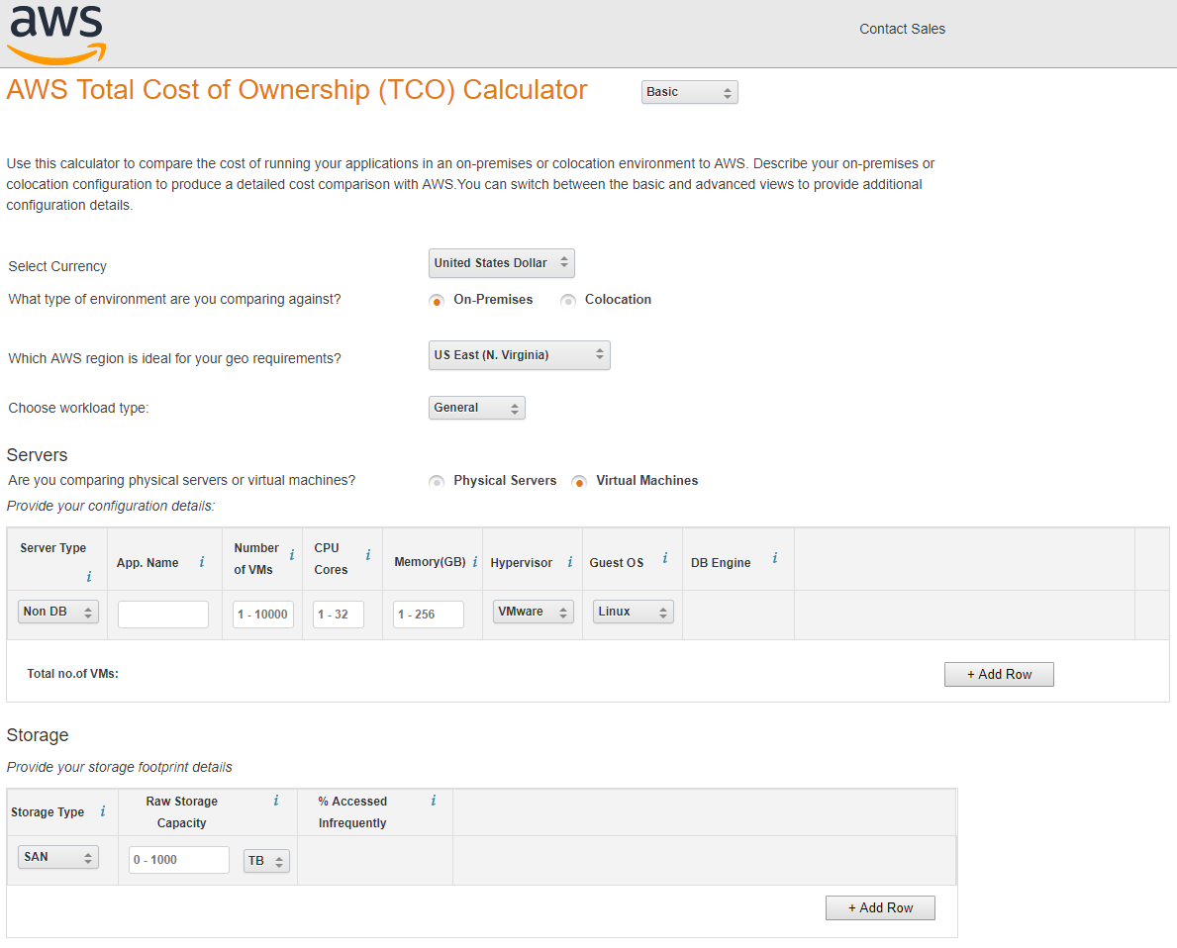
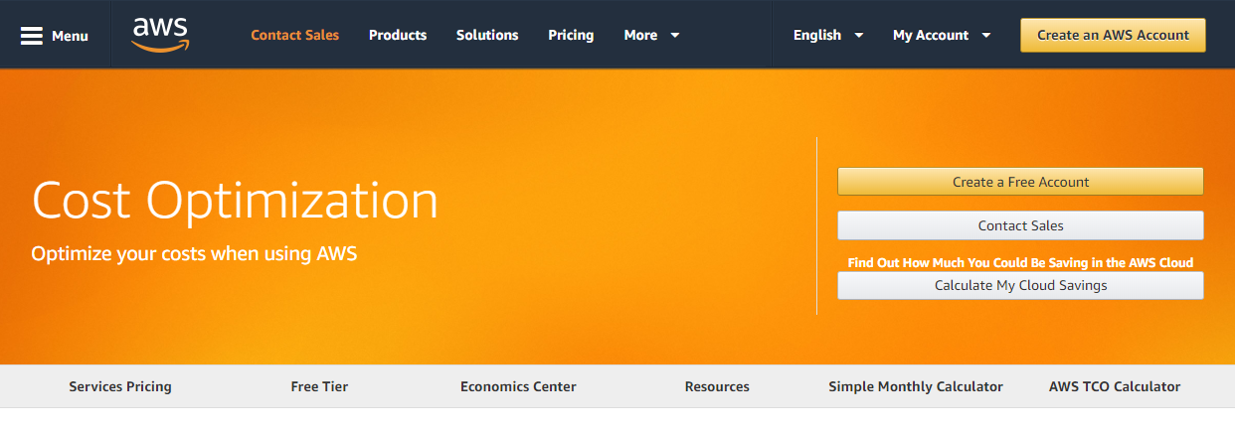
Greater Cost Transparency

Slide 27
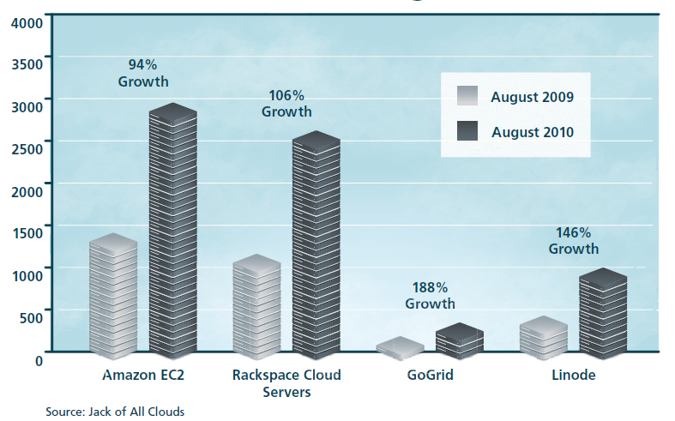
Democratization of Computing
With many Cloud Computing provides, a server capable of running many of the most common web or business applications can be rented for around $11/month
Websites using Cloud Providers

Slide 28
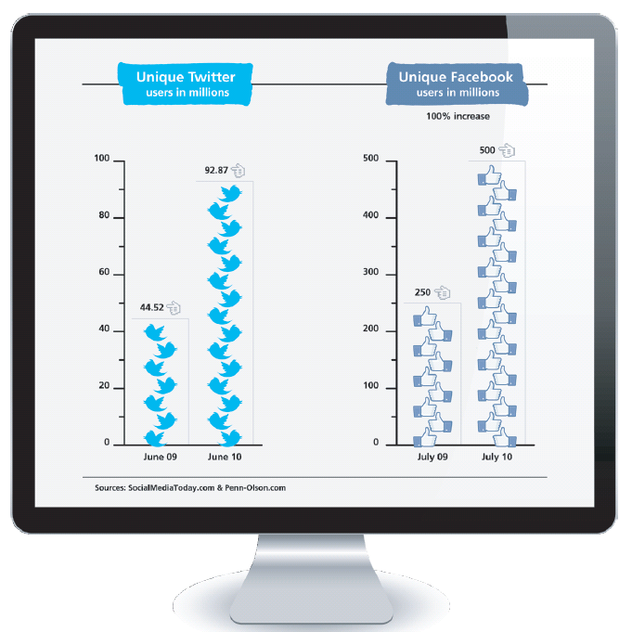

Slide 29
Notes:
Notice how Twitter was able to scale at the time with exponential growth?
For more current Twitter usage, see https://blog.gdeltproject.org/visualizing-eight-years-of-twitters-evolution-2012-2019/
^ Note how current use is largely stable, but there are still spikes of +30%.

Slide 30
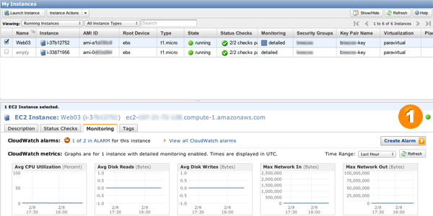
Scalability and Fast Provisioning

Slide 31
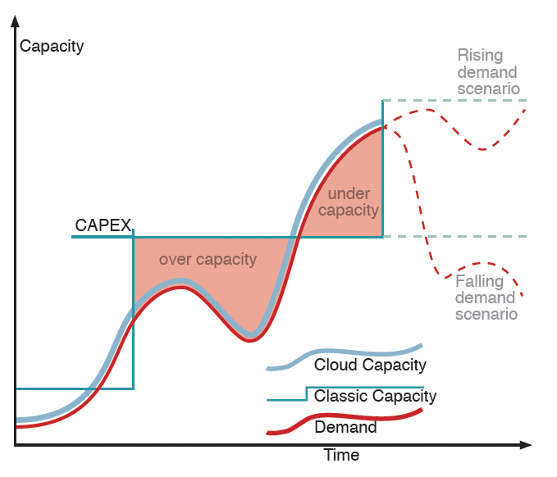
Scalability and Fast Provisioning

Slide 32
FYI: The 10 Laws of Cloudonomics
Cloudonomics Law #1: Utility services cost less even though they cost more.
Although utilities cost more when they are used, they cost nothing when they are not. Consequently, customers save money by replacing fixed infrastructure with Clouds when workloads are spiky, specifically when the peak-to-average ratio is greater than the utility premium.
Cloudonomics Law #2: On-demand trumps forecasting.
Forecasting is often wrong, the ability to up and down scale to meet unpredictable demand spikes allows for revenue and cost optimalities.
Cloudonomics Law #3: The peak of the sum is never greater than the sum of the peaks.
Enterprises deploy capacity to handle their peak demands. Under this strategy, the total capacity deployed is the sum of these individual peaks. However, since clouds can reallocate resources across many enterprises with different peak periods, a cloud needs to deploy less capacity.
Cloudonomics Law #4: Aggregate demand is smoother than individual.
Aggregating demand from multiple customers tends to smooth out variation. Therefore, Clouds get higher utilization, enabling better economics.
Cloudonomics Law #5: Average unit costs are reduced.
They are reduced by distributing fixed costs over more units of output. Larger cloud providers can therefore achieve economies of scale.
Cloudonomics Law #6: Superiority in numbers.
Superiority in numbers is the most important factor in the result of a combat. Service providers have the scale to fight rogue attacks.
Cloudonomics Law #7: Space-time is a continuum.
Organizations derive competitive advantage from responding to changing business conditions faster than the competition. With Cloud scalability, for the same cost, a business can accelerate its information processing and decision-making.
Cloudonomics Law #8: Dispersion is the inverse square of latency.
Reduced latency is increasingly essential to modern applications. A Cloud Computing provider is able to provide more nodes, and hence reduced latency, than an enterprise would want to deploy.
Cloudonomics Law #9: Don’t put all your eggs in one basket.
The reliability of a system increases with the addition of redundant, geographically dispersed components such as data centers and storage arrays. Cloud Computing vendors have the scale and diversity to do so.
Cloudonomics Law #10: An object at rest tends to stay at rest.
A data center is a very large object. Private data centers tend to remain in locations for reasons such as being where the company was founded, or where they got a good deal on property or a lease. A Cloud service provider can locate greenfield sites optimally and without such limits of legacy logic.

Slide 33
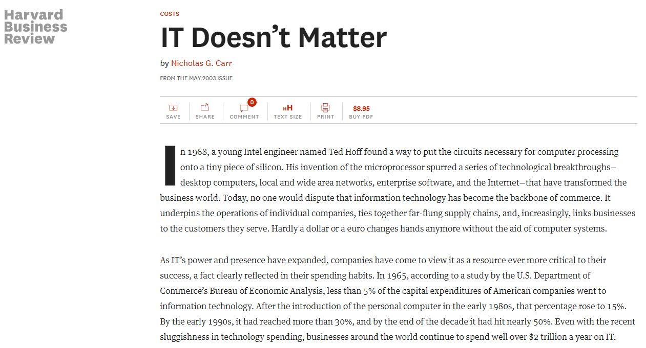
So… IT doesn’t matter?

Slide 34
Remove waste!
30%
70%
On-Premise Infrastructure
Your Business
Managing All of the “Undifferentiated Heavy Lifting”
“Waste is anything that does not lead to direct value for the customer”
Dr. Werner Vogels @ HICSS

Slide 35
Remove waste… with cloud!
30%
70%
On-Premise Infrastructure
Your Business
Managing All of the “Undifferentiated Heavy Lifting”
AWS Cloud-Based Infrastructure
Configuring Your Cloud Assets
More Time to Focus on Your Business
70%
30%
Dr. Werner Vogels @ HICSS

Slide 36
Commoditization of Infrastructure
According to Gartner, IT maintenance at around 80% of total IT expenditure!
The underlying trend here is pressure upon IT departments to produce greater outputs, with less resourcing
Cloud computing offers the ability for IT departments to apply resources as, and where, they are needed
The savings to be gained from a move to the cloud free up IT resources for adding business value rather than simply maintaining the status quo
Time is money, focus on what matters!

Slide 37
Cloud and Innovation
“If you want to increase innovation, you have to lower the cost of failure.”
Joi Ito
Director, MIT Media Lab

Slide 38
Just to list a few…
Human Genome Project
Collaborative project to sequence every single letter of the human genetic code
Terabyte scale datasets and significant computational requirement
BaseSpace
Genomics cloud computing
Dropcam
Biggest inbound video service on the Web
More data uploaded per minute than YouTube!
SCiO
Pocket molecular sensor
Optapro

Slide 39
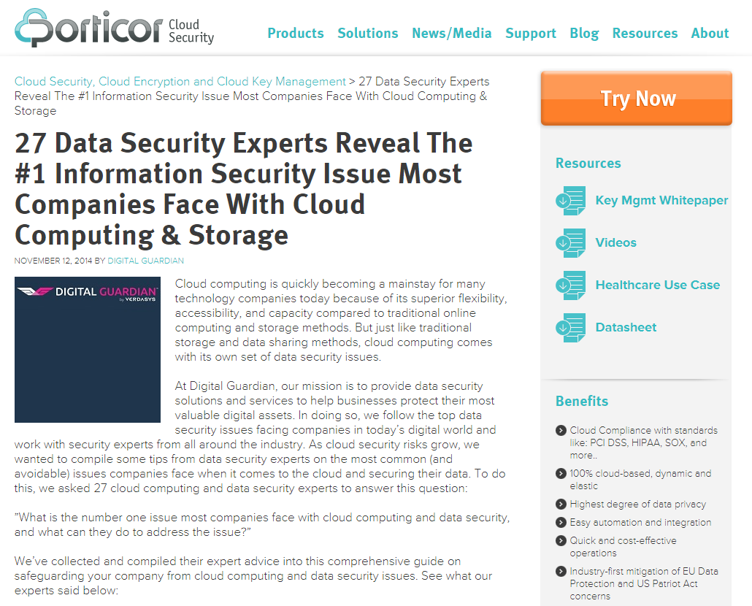
The Moving Frontier: The Cloud

Slide 40
Security

Slide 41
Security Failure May Bring Down Your Business!
Code Spaces Falls After Unauthorized AWS Access
"Code Spaces will not be able to operate beyond this point, the cost of resolving this issue to date and the expected cost of refunding customers who have been left without the service they paid for will put Code Spaces in a irreversible position both financially and in terms of ongoing credibility," the company explained.
(Ref: http://talkincloud.com/public-cloud/062014/code-spaces-falls-after-unauthorized-aws-access)

Slide 42
What Is Computer Security?
Computer Security: protection afforded to an automated information system in order to attain the applicable objectives of preserving the integrity, availability and confidentiality of information system resources (includes hardware, software, firmware, information/data, and telecommunications).

Slide 43
What Is CIA?
Confidentiality: preserving authorized restrictions on information access and disclosure, including means for protecting personal privacy and proprietary information
Loss of confidentiality is the unauthorized disclosure of information
Integrity: guarding against improper information modification or destruction, and includes ensuring information non-repudiation and authenticity
Loss of integrity is the unauthorized modification or destruction of information
Availability: ensuring timely and reliable access to and use of information.
Loss of availability is the disruption of access to or use of information or an information system

Slide 44
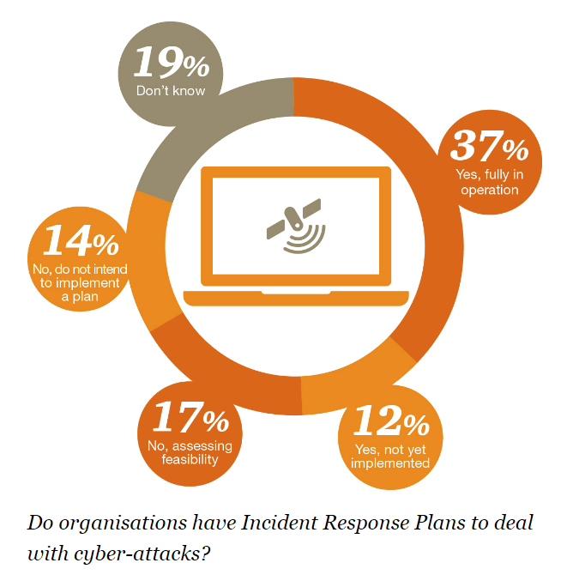
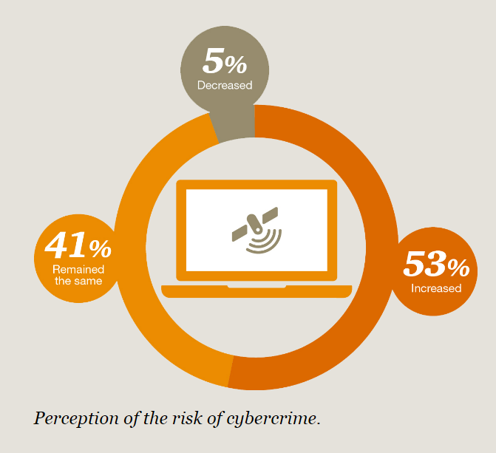
So… here we are.
(http://www.pwc.com/gx/en/services/advisory/forensics/economic-crime-survey/cybercrime.html)

Slide 45
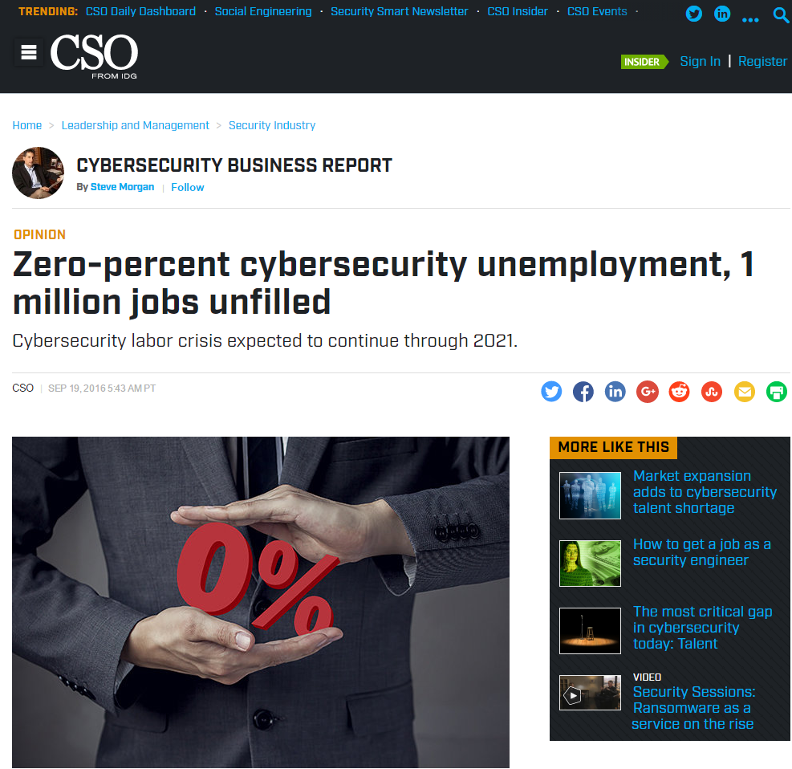
Job Opportunities
(http://www.csoonline.com/article/3120998/techology-business/zero-percent-cybersecurity-unemployment-1-million-jobs-unfilled.html)

Slide 46
Data Breaches Happen Everyday!
http://www.informationisbeautiful.net/visualizations/worlds-biggest-data-breaches-hacks/
Often, attacks are on similar (if not same) mistakes!
“Battle of wits”
Notes:
https://www.cybersecurity-insiders.com/top-5-cloud-security-related-data-breaches/ (2017)
https://www.wsj.com/articles/human-error-often-the-culprit-in-cloud-data-breaches-11566898203 (2019-Aug)

Slide 47
?

Slide 48
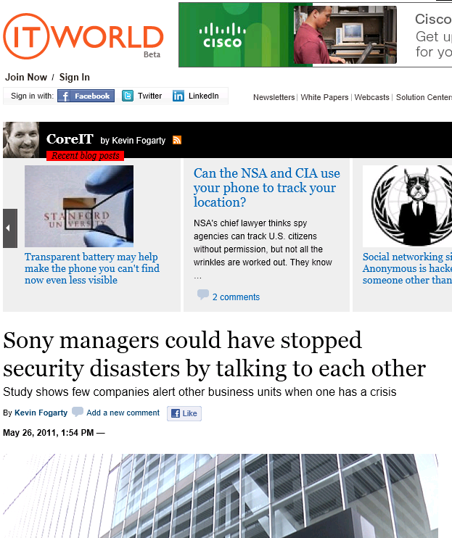
Sony
On April 19, Sony's PlayStation network was penetrated by what Sony Computer Entertainment boss Kaz Hirai told Congress was a "carefully planned, very professional, highly sophisticated criminal cyberattack designed to steal personal and credit card information for illegal purposes.“
A week later, Sony Online Entertainment's network was hit – with a similar attack, presumably by the same crew of hackers.
Sony lost more than 25 million customer records, some including credit card numbers and other personal data.
Since then half a dozen other Sony sites have been hit, most recently a Canadian outpost from which a Lebanese "gray-hat hacker" looking more to teach Sony a lesson than profit from a hack, took customer emails and other information, and posted them as proof of the exploit.
The first breach may be understandable, but a series of breaches all using similar SQL injection techniques shows Sony just isn't paying attention.

Slide 49
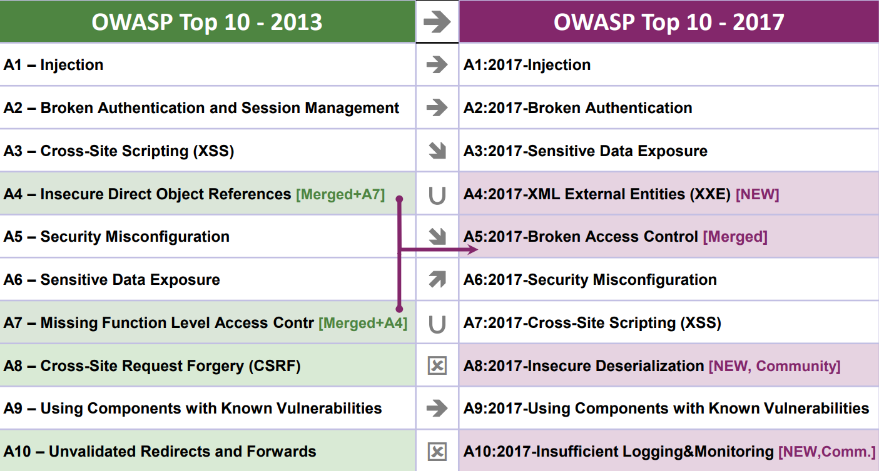
“Oh, that’s so 2011!”

Slide 50
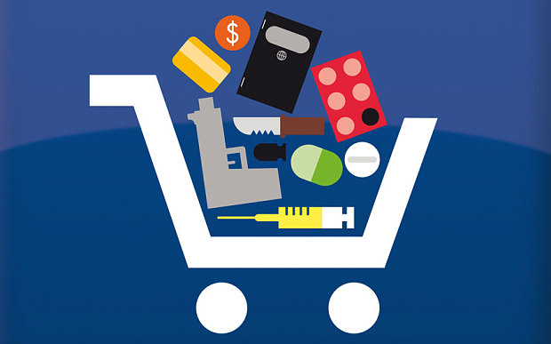
The “Not-So-Holy” Trinity of Dark Net Markets
Anonymous Browsing
Electronic Currencies
Consumer Reviews

Slide 51
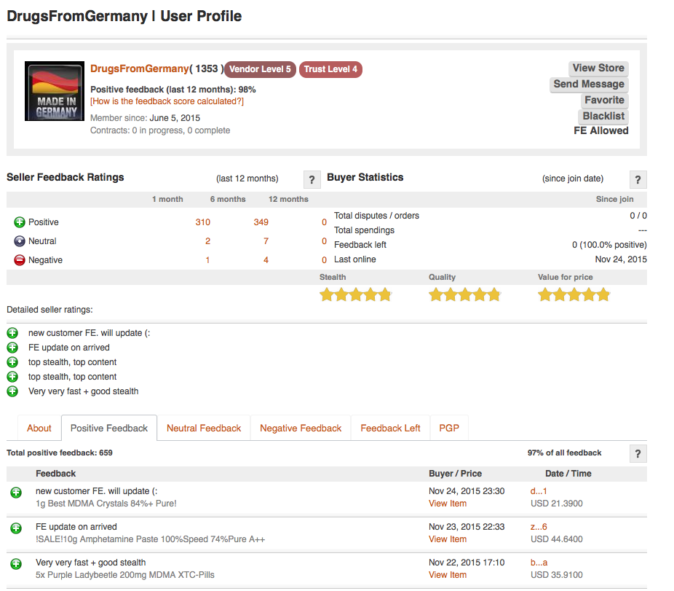
The “Dark Side”
From AlphaBay

Slide 52
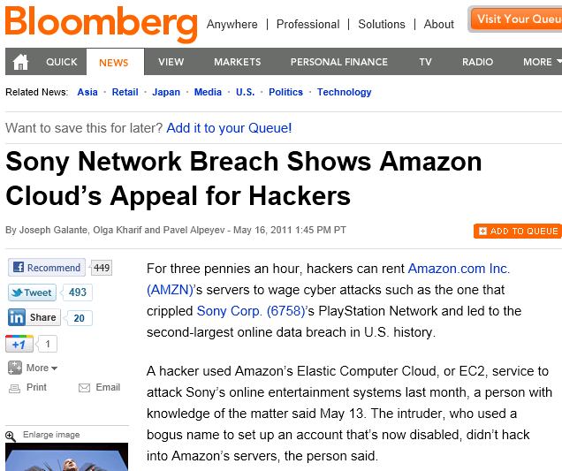
Sony
User name, address, passwords, credit cards,… everything stolen by attackers
"I think what bothers me the most is it took Sony almost a week to tell us," blogger and gamer Jamila Rowser told CBS News' Crimesider. "We could have canceled credit cards and put fraud alerts on our cards days ago."

Slide 53
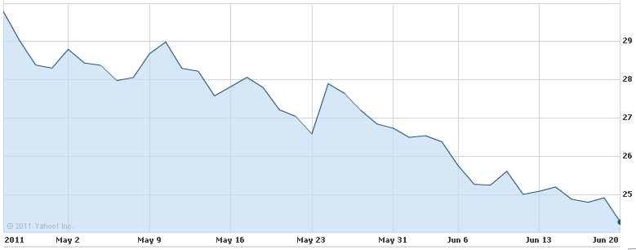
Attack on Sony’s PlayStation Network
“Sony has spent 14 billion yen, which translates to roughly $171 million, to cover the costs of the massive security breach that affected more than 100 million online accounts causing the company to shut down it's online gaming service.”
Check http://www.networkworld.com/news/2011/042711-playstation-network-hack.html for more details.
Notes:
Sony should probably just install a revolving door at the front of their data centers …

Slide 54
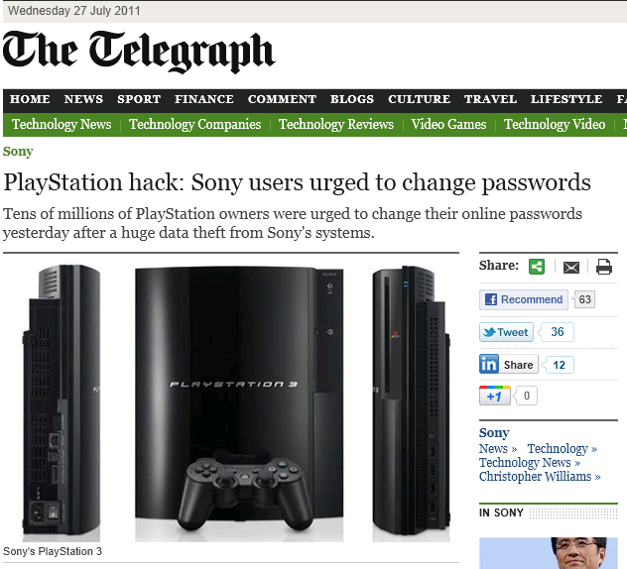
Sony
Online banking and shopping accounts are at risk from cyber criminals after hackers raided the Sony's PlayStation Network and Qriocity service, because of the way internet users reuse passwords.
Sony's systems, which have been shut down for a week, provide online video gaming services and streaming of films and music via the internet. The company has so far refused to confirm whether passwords were stored in files protected by encryption.
The firm has, however, admitted that files of 77million names, addresses, email addresses, birth dates, passwords and usernames were stolen. Sony also said that credit card information may have been stolen, but it had no evidence either way.
Joseph Bonneau, a researcher at the University of Cambridge Computer Laboratory, said: "It's hard to say if leaking passwords or credit card details is a bigger deal.
"Studies show that up to 50 per cent of passwords are reused elsewhere online, so even if the hackers didn't get the credit cards they might be able to access your online banking service using the data they did manage to steal."

Slide 55
Bordering on Sci-Fi
Hackers can crack into cars
Malware can use sound to jump air gaps
Hackers can control your rifle
Read more at: http://www.csoonline.com/article/2985867/vulnerabilities/10-cutting-edge-security-threats.html

Slide 56
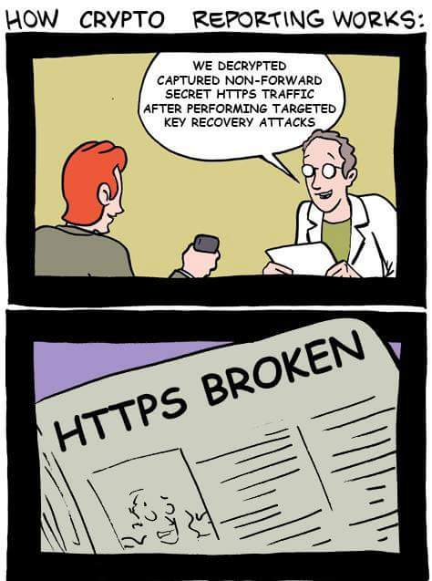
IT Security Consulting Jobs
To be able to understand at this level!
What others see…

Slide 57
Stay Informed!
News Feeds ( Keyword: “cyber security” ) :
https://www.us-cert.gov/ncas/all.xml
https://www.cio.com/
http://www.csoonline.com/
https://www.darkreading.com/
http://www.zdnet.com/
… And many more!!

Slide 58
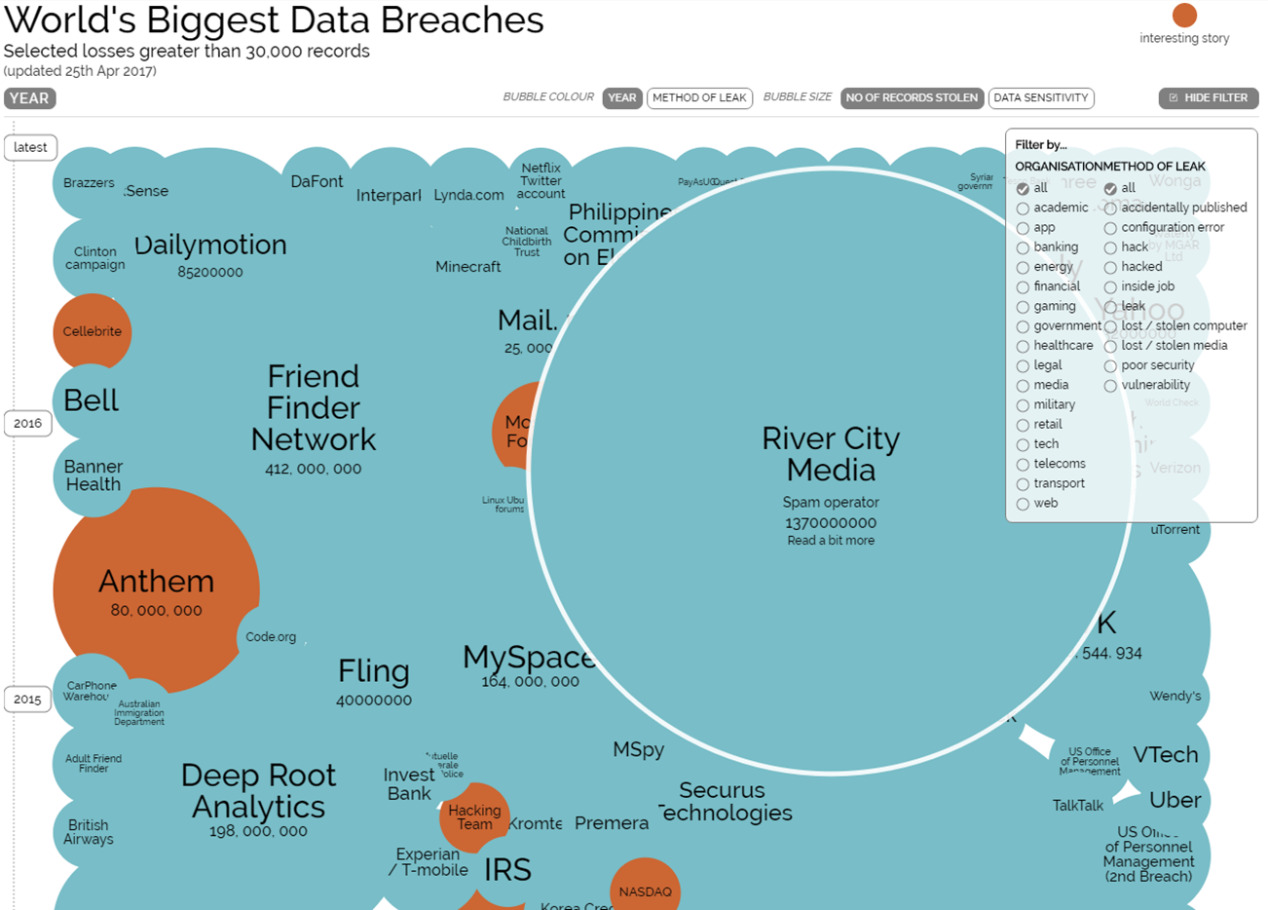
Any Questions?

